Slide 1
Finite Element Analysis of a Compact Clamped-Clamped NEM Relay
Analysis Updates
Akash Levy
5/15/20

Slide 2
Switching from ANSYS to COMSOL: Rationale
ANSYS cannot handle multiphysics as well as COMSOL
No detailed coupling of electrostatic and mechanical domains
COMSOL allows for easier parameter sweeping
COMSOL has native support for importing layouts directly into 3D
COMSOL allows for reproducible steps for fast design iteration
In ANSYS this is only possible with (undocumented) scripting feature
COMSOL has integrated geometry, multiphysics, and analysis steps
COMSOL has much better documentation and support
COMSOL is more transparent about which physics is involved and which solvers are being used

Slide 3
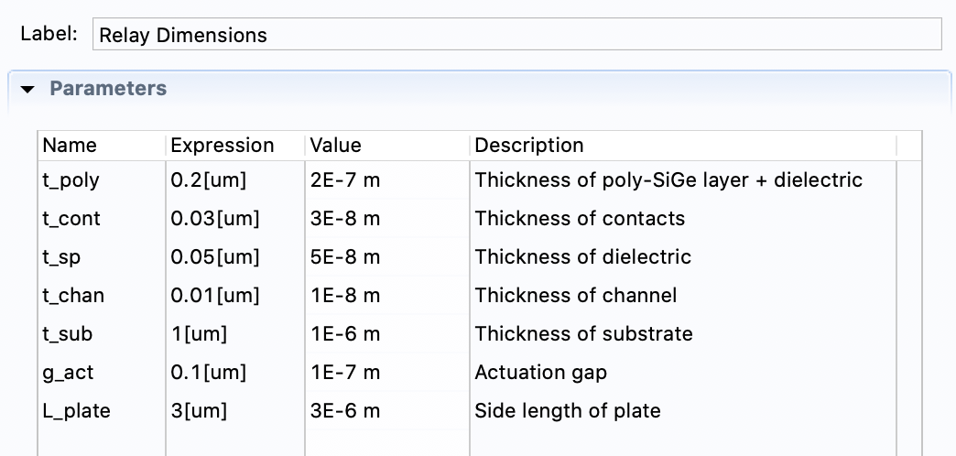
Relay Thickness Dimensions: Parametrized

Slide 4
Relay Components
Relay + Substrate
Spherical Universe
Substrate Components

Slide 5
Meshing
Simple mesh vs. full mesh
Simple mesh uses swept surface mesh on substrate and poly-Si layers and free tetrahedral elements everywhere else
Full mesh uses free tetrahedral elements everywhere
Full mesh used for quick analyses
Simple mesh used for harder analyses

Slide 6
Meshing: Element Statistics
 | Simple | Full
Vertices | 14581 | 17861
Tetrahedra | 59966 | 74693
Pyramids | 1432 | 0
# Elements | 61398 | 74693
Min. Qual. | 0.01999 | 0.1824
Avg. Qual. | 0.5649 | 0.6405
Element Vol. Ratio | 2.495×10⁻⁷ | 3.852×10⁻⁷
Mesh Vol. | 833.7 µm³ | 833.7 µm³

Slide 7
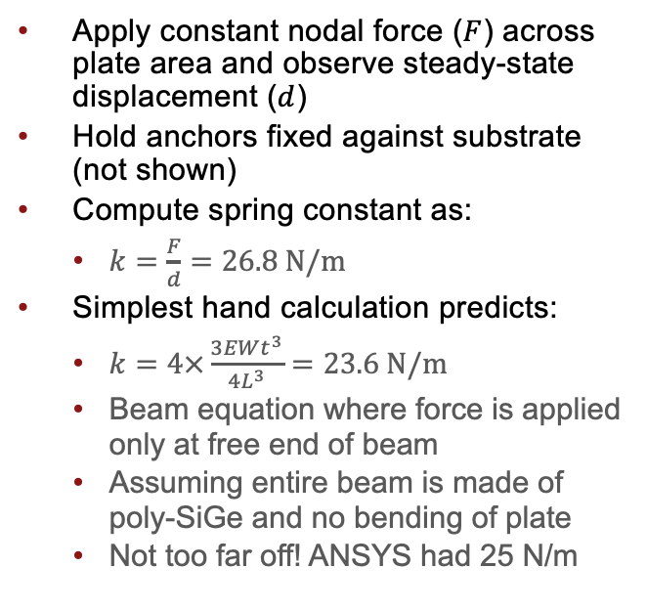
Spring Constant Determination
Apply constant nodal force ($F$) across plate area and observe steady-state displacement ($d$)
Hold anchors fixed against substrate (not shown)
Compute spring constant as:
$k=\frac{F}{d}=26.8 N/m$
Simplest hand calculation predicts:
$k=4×\frac{3EWt^{3}}{{4L}^{3}}=23.6 N/m$
Beam equation where force is applied only at free end of beam
Assuming entire beam is made of poly-SiGe and no bending of plate
Not too far off! ANSYS had 25 N/m
Boundary Loads

Slide 8
Stress and Strain
Elastic stress and strain can help us understand stressed locations
Can show points of possible relay fracture
Hot spots appear at corners
Generally look where differential bending is high
For a 1e-8 N force:
Maximum stress:
Maximum strain:

Slide 9
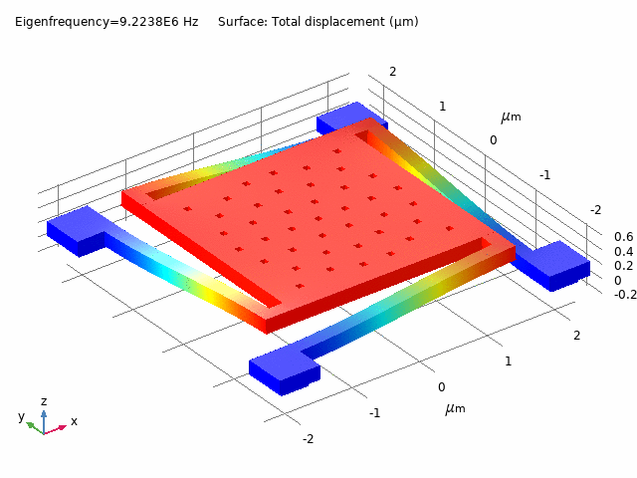
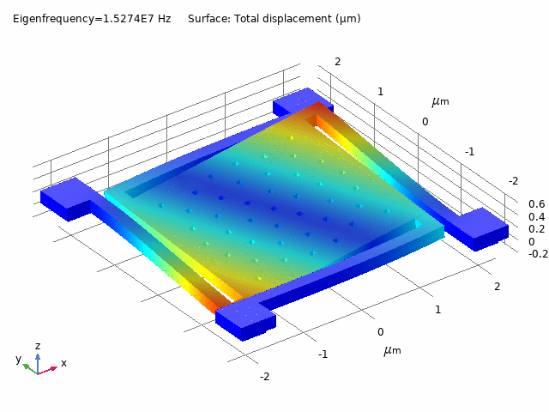
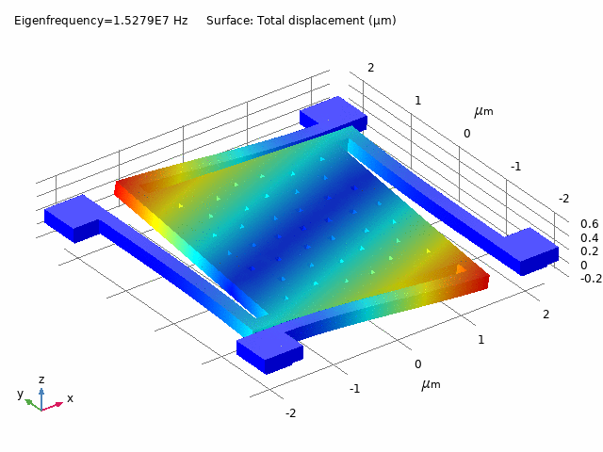
Modal Analysis
Shows dominant modes of relay motion (rotational, flexural, etc.)
Way to understand relay motion and time constants
Can also extract spring constant from the first mode

Slide 10
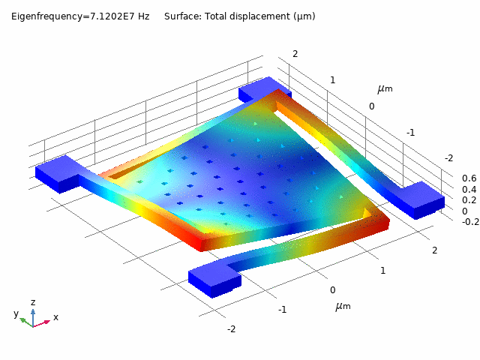
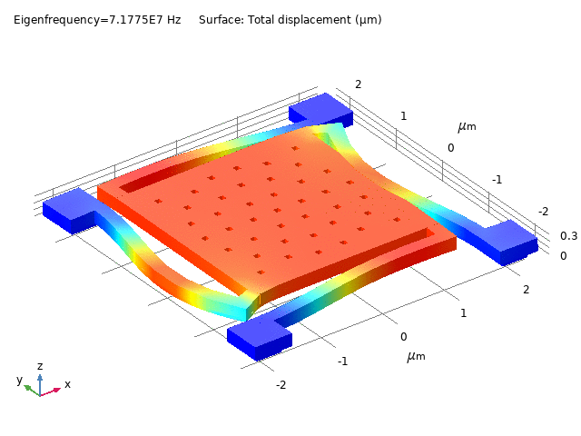
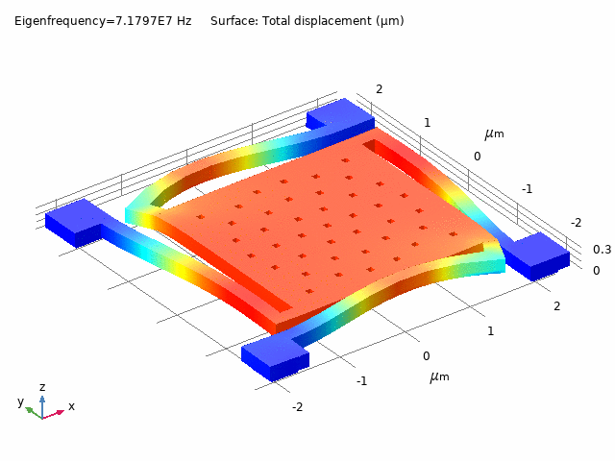
Modal Analysis
Shows dominant modes of relay motion (rotational, flexural, etc.)
Way to understand relay motion and time constants
Can also extract spring constant from the first mode

Slide 11
Modal Analysis with Viscous Damping
mu (Pa*s) | lambda (Hz) | Angular frequency (rad/s) | Damping ratio (1) | Quality factor (1)
0 | 9223781.693505790 | 5.79547296132676E+07 | 0 | Inf
0 | 1.52742778501234E+07 | 9.59711181656742E+07 | 0 | Inf
0 | 1.5278642080978E+07 | 9.59985394368569E+07 | 0 | Inf
0 | 7.12023304549535E+07 | 4.47377436551509E+08 | 0 | Inf
0 | 7.17749745710062E+07 | 4.50975465647735E+08 | 0 | Inf
0 | 7.17973552180903E+07 | 4.51116087400658E+08 | 0 | Inf
0.957 | 9223781.721538266+3052.0243055435703i | 5.7954729789400876E7+19176.43427374634i | 3.30886422793391E-04 | 1511.0925246763700
0.957 | 1.5274277734713791E7+8553.484505964994i | 9.597111744053398E7+53743.1281730675i | 5.59992643408224E-04 | 892.8688722710760
0.957 | 1.527864196195875E7+8558.026436474802i | 9.599853868903668E7+53771.665964112944i | 5.60129958883865E-04 | 892.649986078798
0.957 | 7.120223029435006E7+197400.09694462968i | 4.473768072238775E8+1240301.3887583232i | 0.0027723757740718900 | 180.350731915981
0.957 | 7.177495042352311E7+160368.88929143472i | 4.5097531392462355E8+1007627.4489246523i | 0.002234323925653590 | 223.78133907049300
0.957 | 7.1797330931348E7+160440.37061141155i | 4.5111593480255616E8+1008076.5793040683i | 0.0022346230416505000 | 223.75138476630900
1.8E-05 | 9223781.696337778+0.05439472792822537i | 5.7954729631061524E7+0.34177215530665667i | 5.89722629166541E-09 | 8.47856221333499E+07
1.8E-05 | 1.5274277851157924E7+0.15981877788933338i | 9.597111817217405E7+1.0041709970456572i | 1.04632624498983E-08 | 4.77862428085097E+07
1.8E-05 | 1.527864208073528E7+0.1620845956624576i | 9.599853943533164E7+1.0184075499864975i | 1.06085733801454E-08 | 4.71316907639797E+07
1.8E-05 | 7.120233045621727E7+3.7124258950677875i | 4.4737743655945E8+23.32585983788295i | 5.21391065612744E-08 | 9589730.875276800
1.8E-05 | 7.17749745861163E7+2.965536625797137i | 4.509754657426741E8+18.6330161551115i | 4.1317139335787E-08 | 1.21015154494717E+07
1.8E-05 | 7.179735519738844E7+3.005975202905757i | 4.5111608727058494E8+18.887099228643628i | 4.18674921191957E-08 | 1.19424396994335E+07

Slide 12
Quasi-Static Analysis
Time-dependent analysis
Inertial terms ignored
Damping included to prevent instability of solution
Slowly sweep gate voltage (with relay grounded)
Observe steady-state displacement
Green curve: castor oil
Blue curve: vacuum/air

Slide 13
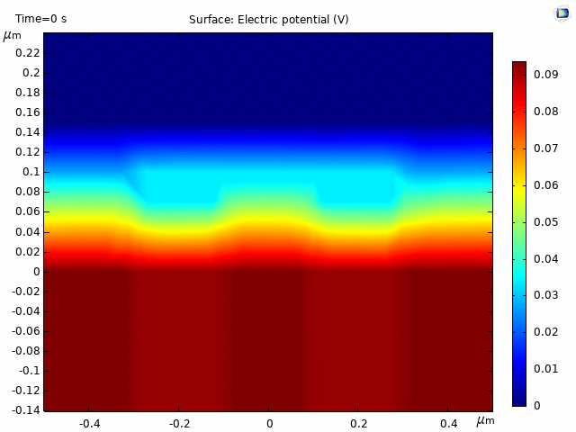
Quasi-Static Analysis
Time-dependent analysis
Inertial terms ignored
Damping included to prevent instability of solution
Slowly sweep gate voltage (with relay grounded)
Observe steady-state displacement
Green curve: castor oil
Blue curve: vacuum/air

Slide 14
Contact Force and Resistance Modeling
Contact cannot be directly modeled with built-in tool when an ambient is present (in both COMSOL and ANSYS
Ambient is required in COMSOL for electric fields to be modeled
Using penalty-based contact force (spring-based method)
Smoothed using exponential decay for convergence
Conserves system energy
Does this approach look valid?

Slide 15
Contact Force and Resistance Modeling

Slide 16
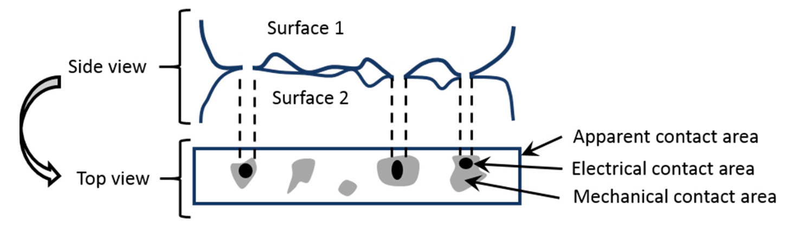
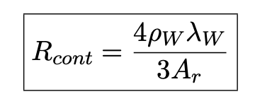
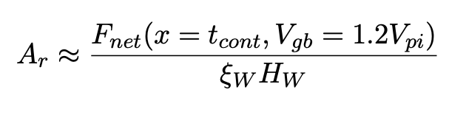
Contact Force and Resistance Modeling
Conclusion is that we need to optimize contact placement
Probably based on FEM-extracted displacement contour
We need multi-pole contact placement for uniform contact resistance
Strategy would be strong addition to a paper
Any good approaches in mind?
Asperity-Based Contact Resistance Model

Slide 17
Contact Force and Resistance Modeling

Slide 18
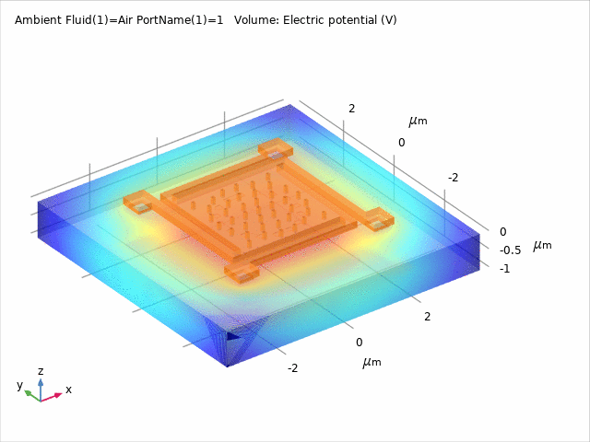
Parasitic Extraction: Technique
Using stationary source sweep
Sets each of the 26 relay terminals to 1V and rest to ground
Relay terminal list:
Gate on Substrate (x1)
Relay Body (x1)
Contact & Channel (x8)
Landing Pads on Substrate (x16)
Models electric field inside spherical universe from earlier
Extracts mutual capacitance using matrix transformation on Maxwell capacitance

Slide 19
Parasitic Extraction: Results
Didn’t include results below 2e-17 F
Capacitance from gate to gate is 1.443e-16 F
Capacitance from gate to body is 1.198e-15 F
Capacitance from gate to landpad1 is 5.484e-16 F
Capacitance from gate to landpad2 is 5.482e-16 F
Capacitance from gate to landpad3 is 5.486e-16 F
Capacitance from gate to landpad4 is 5.484e-16 F
Capacitance from gate to landpad5 is 5.485e-16 F
Capacitance from gate to landpad6 is 5.485e-16 F
Capacitance from gate to landpad7 is 5.481e-16 F
Capacitance from gate to landpad8 is 5.482e-16 F
Capacitance from gate to landpad9 is 5.483e-16 F
Capacitance from gate to landpad10 is 5.483e-16 F
Capacitance from gate to landpad11 is 5.481e-16 F
Capacitance from gate to landpad12 is 5.483e-16 F
Capacitance from gate to landpad13 is 5.489e-16 F
Capacitance from gate to landpad14 is 5.481e-16 F
Capacitance from gate to landpad15 is 5.485e-16 F
Capacitance from gate to landpad16 is 5.483e-16 F
Capacitance from body to gate is 1.198e-15 F
Capacitance from body to body is 3.235e-16 F
Capacitance from body to channel1 is 1.250e-16 F
Capacitance from body to channel2 is 1.276e-16 F
Capacitance from body to channel3 is 1.253e-16 F
Capacitance from body to channel4 is 1.279e-16 F
Capacitance from body to channel5 is 1.250e-16 F
Capacitance from body to channel6 is 1.276e-16 F
Capacitance from body to channel7 is 1.254e-16 F
Capacitance from body to channel8 is 1.280e-16 F
Capacitance from channel1 to body is 1.250e-16 F
Capacitance from channel2 to body is 1.276e-16 F
Capacitance from channel3 to body is 1.253e-16 F
Capacitance from channel4 to body is 1.279e-16 F
Capacitance from channel5 to body is 1.250e-16 F
Capacitance from channel6 to body is 1.276e-16 F
Capacitance from channel7 to body is 1.254e-16 F
Capacitance from channel8 to body is 1.279e-16 F
Capacitance from landpad1 to gate is 5.484e-16 F
Capacitance from landpad2 to gate is 5.482e-16 F
Capacitance from landpad3 to gate is 5.486e-16 F
Capacitance from landpad4 to gate is 5.484e-16 F
Capacitance from landpad5 to gate is 5.485e-16 F
Capacitance from landpad6 to gate is 5.484e-16 F
Capacitance from landpad7 to gate is 5.481e-16 F
Capacitance from landpad8 to gate is 5.483e-16 F
Capacitance from landpad9 to gate is 5.483e-16 F
Capacitance from landpad10 to gate is 5.483e-16 F
Capacitance from landpad11 to gate is 5.481e-16 F
Capacitance from landpad12 to gate is 5.483e-16 F
Capacitance from landpad13 to gate is 5.489e-16 F
Capacitance from landpad14 to gate is 5.481e-16 F
Capacitance from landpad15 to gate is 5.485e-16 F
Capacitance from landpad16 to gate is 5.483e-16 F
Capacitance from gate to gate: (mean, std) = (1.443e-16 F, 0.000e+00 F)
Capacitance from gate to body: (mean, std) = (1.198e-15 F, 3.118e-20 F)
Capacitance from gate to landpad: (mean, std) = (5.484e-16 F, 2.007e-19 F)
Capacitance from body to body: (mean, std) = (3.235e-16 F, 0.000e+00 F)
Capacitance from body to channel: (mean, std) = (1.265e-16 F, 1.317e-18 F)
Capacitance from gate to gate is 4.173e-16 F
Capacitance from gate to body is 3.223e-15 F
Capacitance from gate to channel1 is 4.258e-17 F
Capacitance from gate to channel2 is 4.311e-17 F
Capacitance from gate to channel3 is 4.253e-17 F
Capacitance from gate to channel4 is 4.313e-17 F
Capacitance from gate to channel5 is 4.270e-17 F
Capacitance from gate to channel6 is 4.317e-17 F
Capacitance from gate to channel7 is 4.264e-17 F
Capacitance from gate to channel8 is 4.325e-17 F
Capacitance from gate to landpad1 is 5.752e-16 F
Capacitance from gate to landpad2 is 5.746e-16 F
Capacitance from gate to landpad3 is 5.750e-16 F
Capacitance from gate to landpad4 is 5.754e-16 F
Capacitance from gate to landpad5 is 5.755e-16 F
Capacitance from gate to landpad6 is 5.750e-16 F
Capacitance from gate to landpad7 is 5.748e-16 F
Capacitance from gate to landpad8 is 5.751e-16 F
Capacitance from gate to landpad9 is 5.754e-16 F
Capacitance from gate to landpad10 is 5.754e-16 F
Capacitance from gate to landpad11 is 5.747e-16 F
Capacitance from gate to landpad12 is 5.755e-16 F
Capacitance from gate to landpad13 is 5.767e-16 F
Capacitance from gate to landpad14 is 5.744e-16 F
Capacitance from gate to landpad15 is 5.753e-16 F
Capacitance from gate to landpad16 is 5.755e-16 F
Capacitance from body to gate is 3.223e-15 F
Capacitance from body to body is 1.096e-15 F
Capacitance from body to channel1 is 1.392e-16 F
Capacitance from body to channel2 is 1.417e-16 F
Capacitance from body to channel3 is 1.394e-16 F
Capacitance from body to channel4 is 1.419e-16 F
Capacitance from body to channel5 is 1.393e-16 F
Capacitance from body to channel6 is 1.418e-16 F
Capacitance from body to channel7 is 1.395e-16 F
Capacitance from body to channel8 is 1.420e-16 F
Capacitance from channel1 to gate is 4.258e-17 F
Capacitance from channel1 to body is 1.392e-16 F
Capacitance from channel2 to gate is 4.311e-17 F
Capacitance from channel2 to body is 1.417e-16 F
Capacitance from channel3 to gate is 4.253e-17 F
Capacitance from channel3 to body is 1.394e-16 F
Capacitance from channel4 to gate is 4.313e-17 F
Capacitance from channel4 to body is 1.419e-16 F
Capacitance from channel5 to gate is 4.270e-17 F
Capacitance from channel5 to body is 1.393e-16 F
Capacitance from channel6 to gate is 4.317e-17 F
Capacitance from channel6 to body is 1.418e-16 F
Capacitance from channel7 to gate is 4.264e-17 F
Capacitance from channel7 to body is 1.395e-16 F
Capacitance from channel8 to gate is 4.325e-17 F
Capacitance from channel8 to body is 1.420e-16 F
Capacitance from landpad1 to gate is 5.752e-16 F
Capacitance from landpad2 to gate is 5.746e-16 F
Capacitance from landpad3 to gate is 5.750e-16 F
Capacitance from landpad4 to gate is 5.754e-16 F
Capacitance from landpad5 to gate is 5.755e-16 F
Capacitance from landpad6 to gate is 5.750e-16 F
Capacitance from landpad7 to gate is 5.748e-16 F
Capacitance from landpad8 to gate is 5.751e-16 F
Capacitance from landpad9 to gate is 5.754e-16 F
Capacitance from landpad10 to gate is 5.754e-16 F
Capacitance from landpad11 to gate is 5.747e-16 F
Capacitance from landpad12 to gate is 5.755e-16 F
Capacitance from landpad13 to gate is 5.767e-16 F
Capacitance from landpad14 to gate is 5.744e-16 F
Capacitance from landpad15 to gate is 5.753e-16 F
Capacitance from landpad16 to gate is 5.755e-16 F
Capacitance from gate to gate: (mean, std) = (4.173e-16 F, 0.000e+00 F)
Capacitance from gate to body: (mean, std) = (3.223e-15 F, 1.049e-21 F)
Capacitance from gate to landpad: (mean, std) = (5.752e-16 F, 5.282e-19 F)
Capacitance from body to body: (mean, std) = (1.096e-15 F, 0.000e+00 F)
Capacitance from body to channel: (mean, std) = (1.406e-16 F, 1.249e-18 F)
Air/Vacuum
Castor Oil
Capacitance of min size inverter in 40nm tech on order of ~1e-16

Slide 20
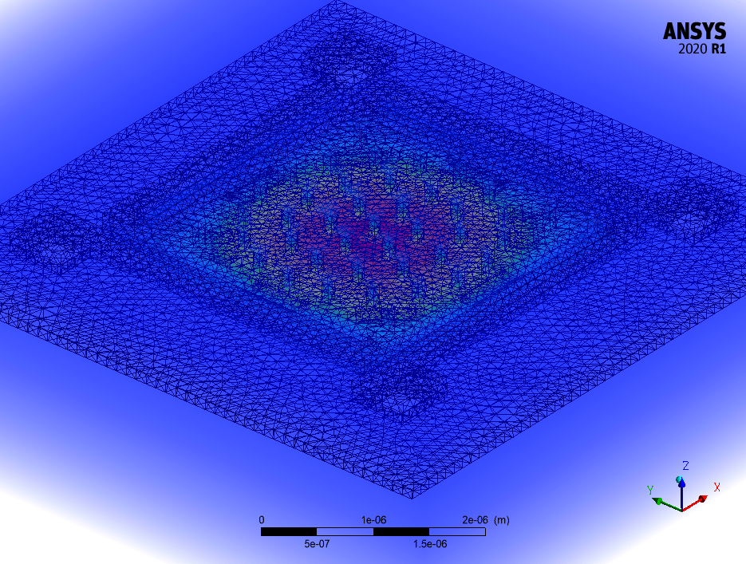
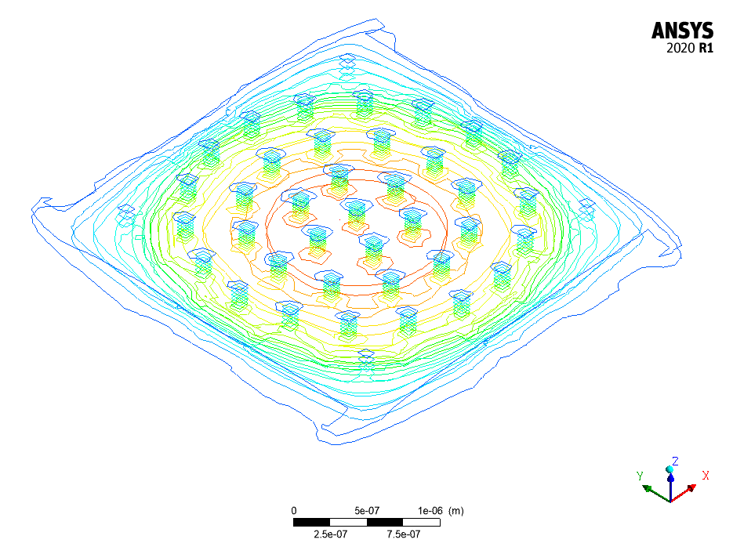
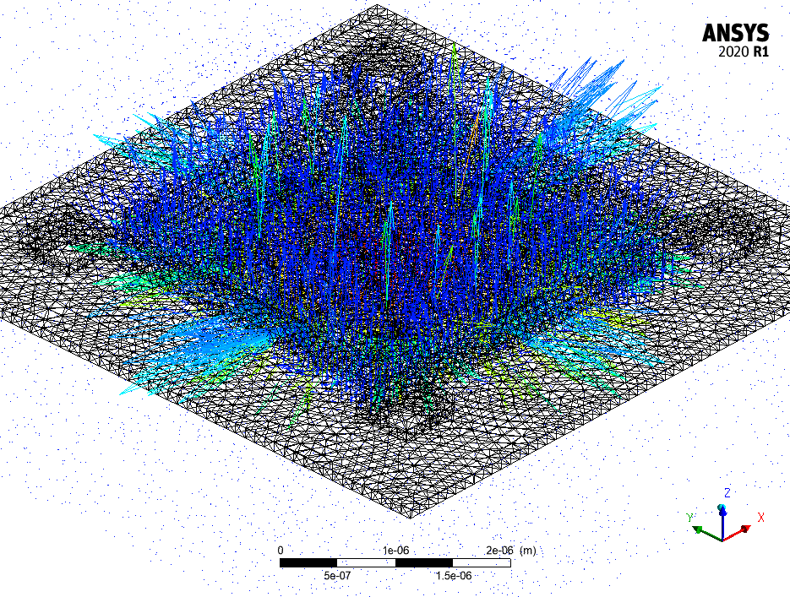
ANSYS Plots From CFD
Pressure
Pressure Contour
Velocity

Slide 21
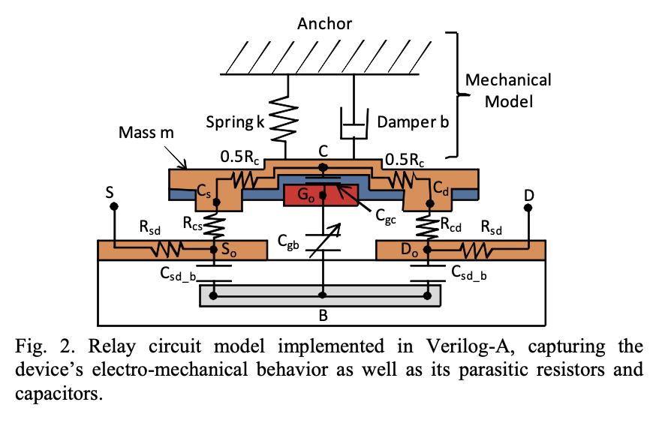
Goal for SPICE Model
Ultimately, we want to work with reduced-order models suitable for SPICE simulation
Goal: extract key parameters that capture essence of FEA model
Possible simplified model of relay is shown below (from Berkeley)

Slide 22
Thank you!
Questions?

